Slide 1
Stage 1: The digestive system

Slide 2
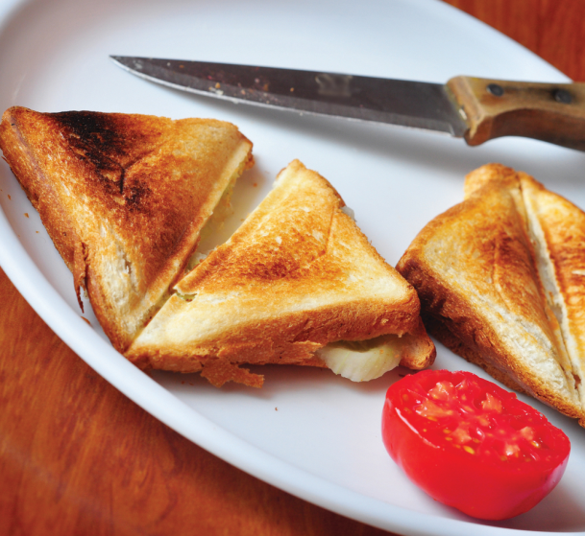
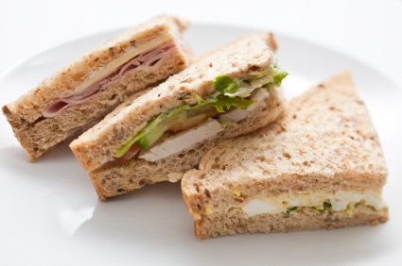
The Challenge!
Year 4!
The children of the UK need your help!
Every day, they peer hopefully into their lunchboxes only to be greeted by the same old offerings: bland baguettes, tasteless toasties and yet another packet of stale sandwiches!
We are giving YOU the task of setting up your own farm shop business to grow your ingredients, design and make a brand new, calcium-rich lunchtime food and save the children of the UK from their lunchtime boredom.
Good luck!

Slide 3
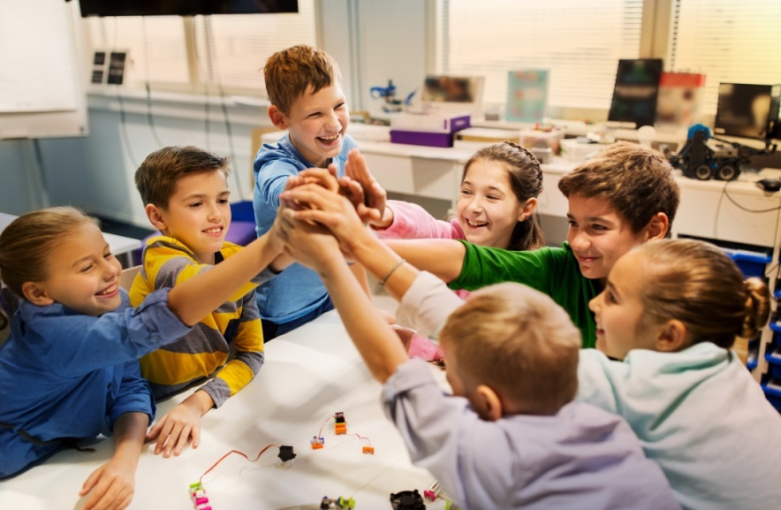
We are going to be developing our own recipes to make a brand new, calcium-rich lunchtime food product for our farm shop businesses.
You have 5 minutes to think of a name for your farm shop business.

Slide 4
Learning Objective:
To identify the organs involved in the digestive system and their functions
Before we can start developing our healthy new product, we need to understand how the digestive system works.
Talk to your group: what job do you think the digestive system does?

Slide 5
The digestive system
The digestive system is responsible for processing the food that we eat so that our bodies can absorb the nutrients they needs and expel (get rid of) the waste products that they don’t need.
Warm up: draw what you think the digestive system looks like on the body diagram sheet.

Slide 6
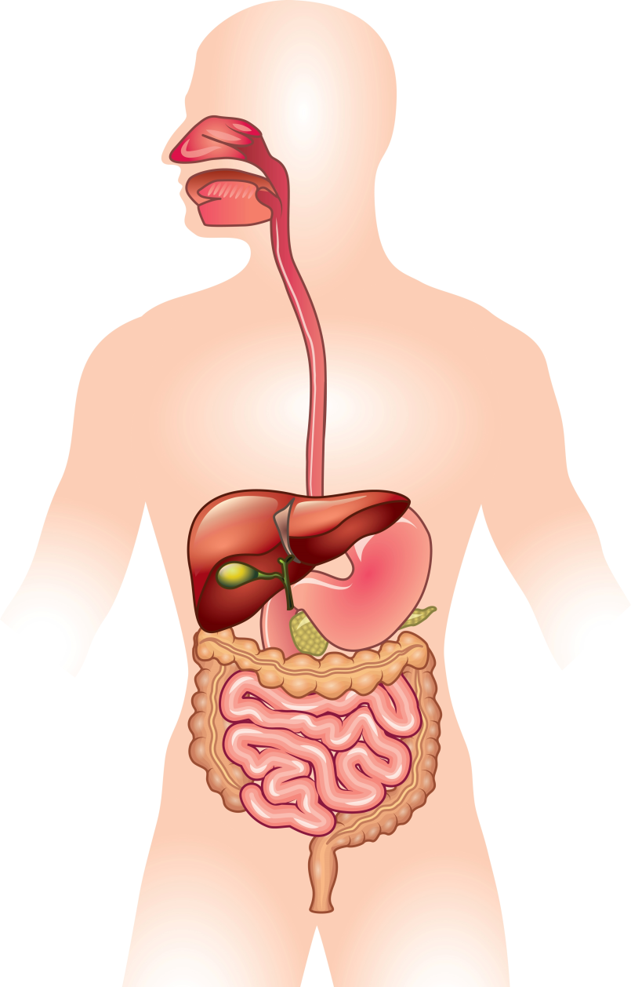
The digestive system
Step 1: Mouth
Food is chewed by the teeth and the salivary glands produce saliva which helps to break up the food further.
Step 2: Oesophagus
Once chewed, food enters the oesophagus, a muscular tube that contracts and pushes the food down into the stomach.
Step 3: Stomach
The stomach has strong muscular walls that contract to churn up the food. It produces acids and enzymes that break down the food further.
Bonus round!
What do plants need to grow?
Step 4: Small intestine
Most food is digested here. Nutrients are absorbed through the wall of the small intestine and taken back into the body as food is pushed along.
Step 5: Large intestine
Anything that has not been digested in the small intestine passes to the large intestine. Here, water and some vitamins are absorbed into the body and any undigested food hardens and passes out of the anus as faeces when we go to the toilet.

Slide 7
Task 1: Building the digestive system
Now we are going to work in groups to build our own digestive systems and see how they work.

Slide 8
Task 2: Labelling the digestive system
Show off all the progress you have made this lesson by labelling the diagram with all the names and functions you have learnt today.

Slide 9
Task 3: Applying your learning
Imagine that you are a piece of food who is embarking on a journey through the digestive system.
Describe your experiences.

